Slide 1

RD50 Status Report – May 2016
RD50
LHCC – 25.May 2016, CERN
Gianluigi Casse Michael Moll University of Liverpool, UK CERN, Geneva, Switzerland & FBK-CMM, Trento, Italy .
OUTLINE:
RD50 Collaboration
Scientific results (some highlights)
Defect and Material Characterization
Detector Characterization
New Detector Structures
Full Detector Systems
RD50 Work Program 2016/2017
RD50 achievements, common projects and key results 2015/16 (spare slides)

Slide 2
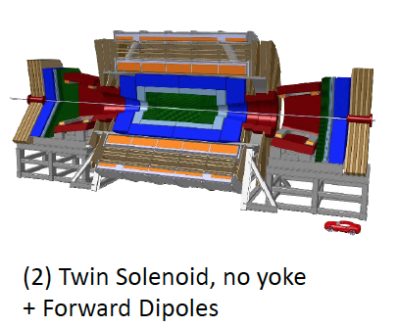
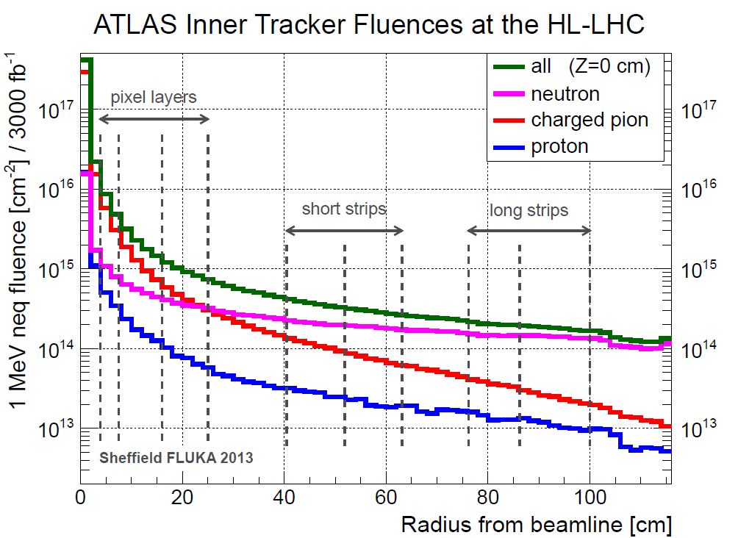
Motivation and Challenge
LHC upgrade
LHC upgrade towards High Luminosity LHC (HL-LHC) after LS3 (~2024-26); expect 3000 fb⁻¹ (x6 nominal LHC)
FCC – Future Circular Collider
….later than 2035
Radiation levels innermost pixel layer (30ab⁻¹, without safety factor): 7x10¹⁷ n_{eq}/cm², 200MGy
[W.Riegler, RD50 Workshop, 12/2015]
[I. Dawson, P. S. Miyagawa, Sheffield University, Atlas Upgrade radiation background simulations]
Semiconductor detectors will be exposed to hadron fluences equivalent to more than 10¹⁶ n_{eq}/cm² (HL-LHC) and more than 7x10¹⁷ n_{eq}/cm² (FCC) ➔ detectors used now at LHC cannot operate after such irradiation
RD50 : mandate to develop and characterize semiconductor sensors for HL-LHC….. and FCC
Notes:
HE: 16.5 TeV (CERN-ATS-2010-177)
Plot taken from Igor Mandic (Vienna 2013 presentation)

Slide 3
The RD50 Collaboration
RD50: 50 institutes and 282 members
42 European and Asian institutes Belarus (Minsk), Belgium (Louvain), Czech Republic (Prague (3x)), Finland (Helsinki, Lappeenranta ), France (Paris, Orsay), Germany (Dortmund, Erfurt, Freiburg, Hamburg (2x), Karlsruhe, Munich(2x)), Italy (Bari, Florence, Perugia, Pisa, Torino), Lithuania (Vilnius), Netherlands (NIKHEF), Poland (Krakow, Warsaw(2x)), Romania (Bucharest (2x)), Russia (Moscow, St.Petersburg), Slovenia (Ljubljana), Spain (Barcelona(2x), Santander, Valencia), Switzerland (CERN, PSI), United Kingdom (Birmingham, Glasgow, Lancaster (new), Liverpool)
6 North-American institutes Canada (Montreal), USA (BNL, Fermilab, New Mexico, Santa Cruz, Syracuse) 1 Middle East institute Israel (Tel Aviv) 1 Asian institute India (Delhi)
+ 4 new institutes requested membership
Detailed member list: http://cern.ch/rd50

Slide 4
RD50 Organizational Structure
Co-Spokespersons Gianluigi Casse and Michael Moll (Liverpool University, UK (CERN EP-DT)
& FBK-CMM, Trento, Italy)
Defect / Material Characterization Ioana Pintilie (NIMP Bucharest)
Detector Characterization Eckhart Fretwurst (Hamburg University)
New Structures Giulio Pellegrini (CNM Barcelona)
Full Detector Systems Gregor Kramberger (Ljubljana University)
Characterization of microscopic properties of standard-, defect engineered and new materials pre- and post- irradiation
DLTS, TSC, ….
SIMS, SR, …
NIEL (calculations)
WODEAN: Workshop on Defect Analysis in Silicon Detectors (G.Lindstroem & M.Bruzzi)
Characterization of test structures (IV, CV, CCE, TCT,.)
Development and testing of defect engineered silicon devices
EPI, MCZ and other materials
NIEL (experimental)
Device modeling
Operational conditions
Common irradiations
Wafer procurement (M.Moll)
Device Simulations (V.Eremin)
Acceptor removal (Kramberger)
3D detectors
Thin detectors
Cost effective solutions
Other new structures
Detectors with internal gain (avalanche detectors)
LGAD:Low Gain Avalanche Det.
Deep depleted Avalanche Det.
Slim Edges
HVCMOS
3D (R.Bates)
LGAD (S.Hidalgo)
Slim Edges (V.Fadeyev)
LHC-like tests
Links to HEP(LHC upgrade, FCC)
Links electronics R&D
Low rho strips
Sensor readout (Alibava)
Comparison: - pad-mini-full detectors - different producers
Radiation Damage in HEP detectors
Test beams (M.Bomben & G.Casse)
Collaboration Board Chair & Deputy: G.Kramberger (Ljubljana) & J.Vaitkus (Vilnius), Conference committee: U.Parzefall (Freiburg) CERN contact: M.Moll (EP-DT), Secretary: V.Wedlake (EP-DT), Budget holder & GLIMOS: M.Glaser (EP-DT)

Slide 5
Defect & Material Characterization

Slide 6
Defect Characterization
space charge trapping leakage current
Aim of defect studies:
Identify defects responsible for Trapping, Leakage Current, Change of N_{eff ,} Change of E-Field
Understand if this knowledge can be used to mitigate radiation damage (e.g. defect engineering)
Deliver input for device simulations to predict detector performance under various conditions
Method: Defect Analysis performed with various tools inside RD50:
C-DLTS (Capacitance Deep Level Transient Spectroscopy)
TSC (Thermally Stimulated Currents)
PITS (Photo Induced Transient Spectroscopy)
FTIR (Fourier Transform Infrared Spectroscopy)
EPR (Electron Paramagnetic Resonance)
TCT (Transient Current Technique)
CV/IV (Capacitance/Current-Voltage Measurement)
PC, RL, I-DLTS, TEM,… and simulation
RD50: several hundred samples irradiated with protons, neutrons, electrons and ⁶⁰Co-γ
… significant progress on identifying defects responsible for sensor degradation over recent years!
[Elena Donegani et al, UniHH, RD50 Workshop, December 2015]
Example: TSC measurement on defects produced by 23 MeV protons

Slide 7
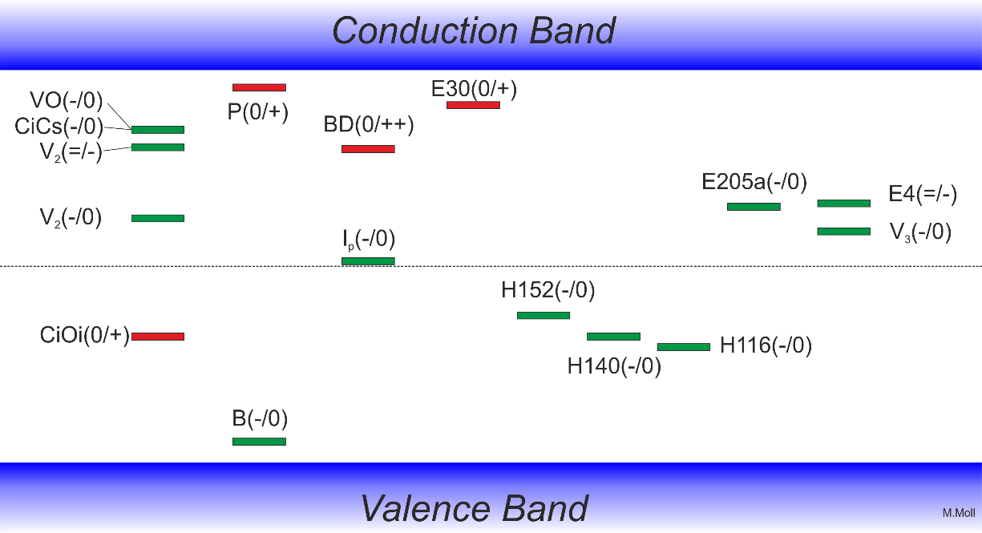
Summary on defects with strong impact on device performance after irradiation
Some identified defects
Trapping: Indications that E205a and H152K are important (further work needed)
Converging on consistent set of defects observed after p, π, n, γ and e irradiation.
Defect introduction rates are depending on particle type and particle energy and (for some) on material!
positive charge (higher introduction after proton than after neutron irradiation, oxygen dependent)
positive charge (higher introduction after proton irradiation than after neutron irradiation)
Phosphorus: shallow dopant (positive charge)
Leakage current: V₃
leakage current & neg. charge current after γ irrad, V₂O (?)
Reverse annealing (negative charge)
Boron: shallow dopant (negative charge)
A table with levels and cross sections is given in the spare slides.

Slide 8
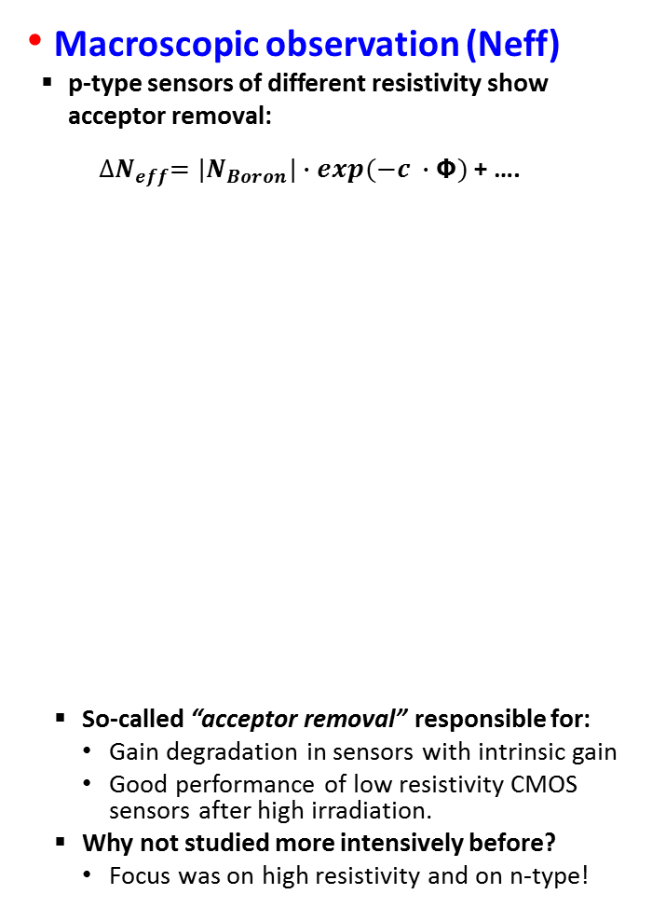
Acceptor removal - Boron related defects?
Microscopic study of defects
TSC (Thermally Stimulated Current) comparing n- and p-type sensors
Reminder: Deep acceptors (H(116K)..) and shallow donors (E30K) alter space charge
Some defect only seen in p-type (Boron containing) material; indication for “Boron removal” by defect kinetics (e.g. B_{i} → B_{i}O_{i} )
Macroscopic observation (Neff)
p-type sensors of different resistivity show
acceptor removal: ${∆N}_{eff}=|N_{Boron}|∙exp(−c ∙Φ)$ + ….
So-called “acceptor removal” responsible for:
Gain degradation in sensors with intrinsic gain
Good performance of low resistivity CMOS sensors after high irradiation.
Why not studied more intensively before?
Focus was on high resistivity and on n-type!
[simplified]
[Gregor Kramberger et al, Ljubljana, RD50 Workshop, June 2015]
[Elena Donegani et al, UniHH, RD50 Workshop, December 2015]

Slide 9
Device Characterization and TCAD simulations

Slide 10
Investigation on extreme fluences
Why?:
Future applications (e.g. forward calorimeters at the LHCC, FCC detectors, …) will face radiation levels in the order of 1x10¹⁷ n_{eq} cm⁻² and beyond!
Helps to understand limits of our parameterizations and modelling!
CCE (Sr⁹⁰) as measured on pad sensors: Surprisingly high charge, low current
Linear extrapolation (depletion, leakage, trapping) does not work!
Working on new parameterization for Efield, leakage, trapping, charge collection.
[G. Kramberger et al. 2013 JINST 8 P08004]
[M.Mikuz, Ljubljana, RD50 Workshop, 12/2015]
Collecting 1000 electrons after 10¹⁷ cm⁻²
Strong indication that the mobility decreases with fluence (e.g. factor 6 at 10¹⁷cm⁻²)!

Slide 11
RD50 Simulation working group
Aim: Develop simulations (TCAD input parameters) allowing to simulate performance of irradiated silicon sensors and performance predictions under various conditions (sensor design and material, irradiation fluence and particle type, annealing,…).
Close collaboration with CMS, AIDA and ATLAS sensor simulation working groups
Challenge for irradiated sensors:
Correct implementation of bulk and surface damage by defect levels
Defect concentration is function of fluence, particle type, material, annealing, …. !
Status:
The defect analysis results drive the construction of the radiation damage model to be implemented in TCAD packages to be able to simulate of the performance of complex silicon devices after hadron irradiation. The simulation output is increasingly accurate in term of IV, CV, CCE inter-electrode resistance and capacitance, break-down voltage prediction etc.
Example: CMS phase II pixel design studies [Understanding peak E-Field]
Evaluating different pixel layout designs and production parameters (p-stop, p-spray)
[G.Jain, Delhi, RD50 Workshop 12/2015]

Slide 12
TCAD Simulations: Status
Bulk damage studies
Optimization of TCAD parameters
TCT – Transient Current Technique and other methods used to produce data sets
CCE in strip or pixel sensors
Complex geometries evaluated against test beam data
Good agreement between data and measurement
Simulations get predictive power (taking into account validity range of model!)
Surface damage
SiO₂ charge-up and Si-SiO₂ interface states
Important role in detector performance: some properties can only be understood if implementing surface damage in simulation
Surface damage properties (e.g. R_{int}) can also only be understood if bulk damage is included!
Figure: Left: Simulated and measured inter-strip resistance vs. fluence for n-on-p strip sensors with double p-stop isolation at V = 600V. 2 interface traps used and bulk defects. Right: Comparison n-in-p vs. p-in-n
Example: Random Noise Hits in n-type strip sensors explained by E-Field at surface: One of the arguments for CMS to decide for p-type sensors.
Φ_{eq}=10¹⁵cm⁻²; 400V
[ RD50 simulations; Summary: T. Peltola, POS, arXiv: 1509.08657v1; 2015 ]

Slide 13
Comparing models and simulators
Cross checking various models and data fitting within the TCAD simulators
Many published TCAD models for irradiated sensors
usually optimized for specific data sets with focus on specific parameters (e.g. depletion voltage, reverse current, charge collection)
often not applicable to (or not tested for) e.g. different fluence or temperature range !
New RD50 approach: Understand limits of available models and obtain more consistent parameter set by fitting full data sets (CV,IV, CCE of diodes) within the TCAD simulator.
Minimize difference between measured and simulated IV,CV curves
Simulation of IV and CV curves & optimization of parameters (“new”)
Compare against CCE (1060nm)
[J.Schwandt, Hamburg, RD50 Workshop, 12/2015]

Slide 14
Segmented Sensors with read-out at the n⁺ contact (n-in-p or n-in-n)

Slide 15
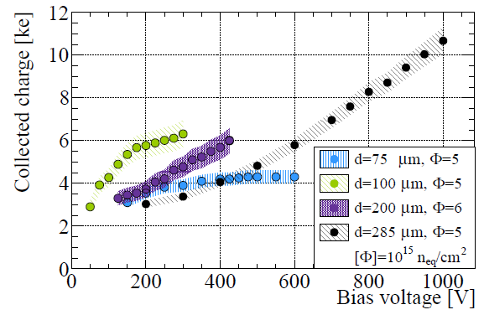
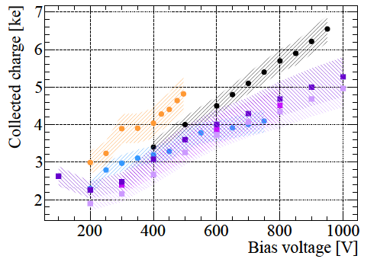
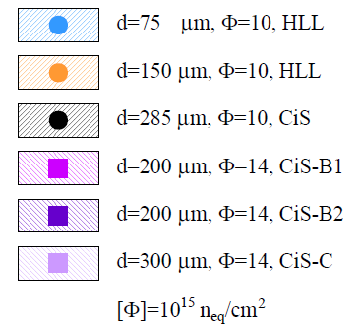
Thin p-type pixel sensors
Thin FZ p-type pixel sensors: 75 to 300 μm with 450 μm edge (MPI/CIS/VTT)
ATLAS FEI4, 25 MeV protons, 800 MeV protons, neutrons, data obtained with beta source
Detectors irradiated with 5 10¹⁵ n_{eq}/cm²
100μm thick sensors give more charge than 75μm thick sensors, both saturate with voltage
200 μm thick sensors give more charge than 300 μm thick sensors at moderate voltage
Beam tests show 97-99% hit efficiency (thickness tested 100 -200 μm, 500V)
Detectors irradiated up to 1.4 10¹⁶ n_{eq}/cm²
Sensor modules still functional (even if in homogeneously irradiated)
B. Paschen, 25th RD50 Workshop Nov. 2014
S. Terzo, 24th RD50 Workshop June 2014

Slide 16
New structures
..optimizing for
Radiation hardness
Time resolution
Cost effectiveness
LGAD, APD (Sensors with intrinsic gain)
HVCMOS (towards monolithic sensors)
3D (sensors with vertical electrodes)

Slide 17
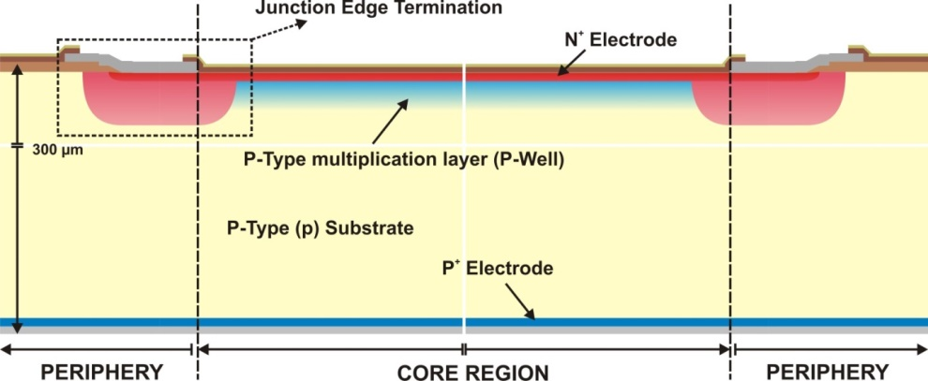
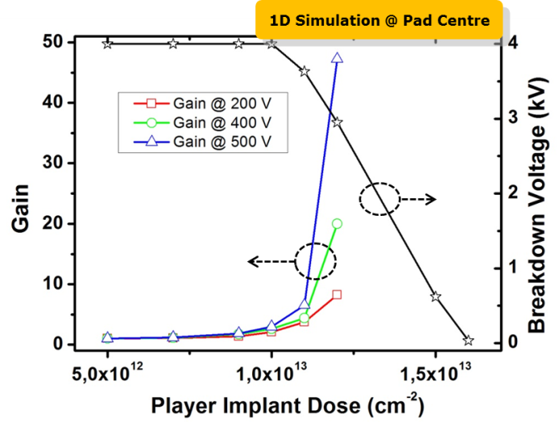
Sensors with intrinsic gain (LGAD)
Exploit impact ionization (charge multiplication in high field regions) to achieve faster (→ improve timing performance) and radiation harder (→ mitigate trapping) sensors.
Main focus: LGAD (Low Gain Avalanche Detectors) gain O(10), some work on DD-APD’s.
LGAD structure:
Core Region: Uniform electric field, high enough to activate impact ionization
Termination: Confining the high electric field of the core region
Optimization: TCAD simulations and studies on prototype devices
Considerations for optimization:
Gain versus V_{breakdown} trade-off, timing performance
Thin detector integration, radiation hardness
Proportional Response (linear mode operation)
Better S/N ratio (small cell volumes and fast shaping times)
Since 2010: 18 production runs at CNM (see spare slides)
[G. Pellegrini et. al., NIM A 765, 2014, 12–16]

Slide 18
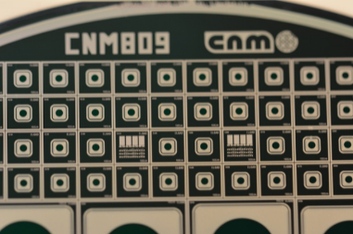
LGAD – Radiation Damage
Radiation Hardness is limited: “Acceptor removal problem”
Collected Charge is degrading with fluence (i.e. we are loosing the “gain”)
TCAD simulations and CV, e-TCT, TCT measurements point out two mechanisms:
Boron removal [Boron bound into defects, i.e. de-activation of shallow dopant]
Space charge build-up due to increased hole current from amplification
Experimental approaches in new production runs:
Use Gallium instead of Boron to impact on defect kinetics [wafers ready]
Use Carbon co-implant to “protect” Boron from removal [to be done]
[G.Kramberger, RD50 Workshop, June 2014 ]
Gallium doped wafer produced, ..to be tested

Slide 19
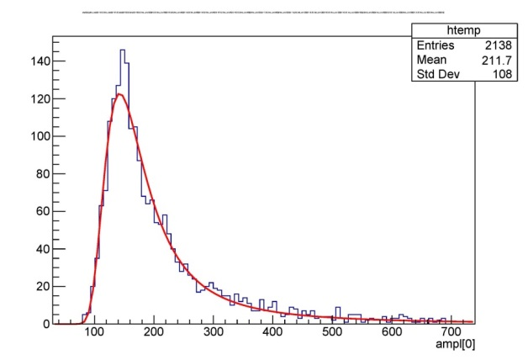
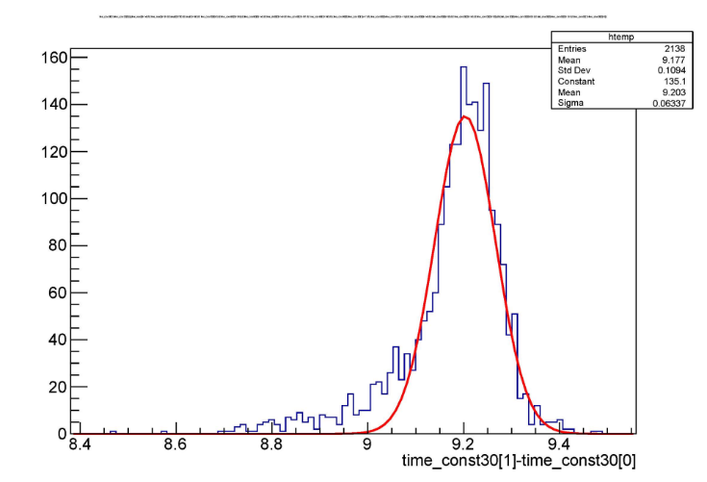
LGAD – Time resolution
Time resolution as predicted by simulations
Weightfield 2 program
Test beam data
300µm LGAD (Gain = 10), 120 GeV π
σ_{Time} = 120ps
[H. Sadrozinski et al. 2016., 10.1016/j.nima.2016.03.093]
Data
[N.Cartiglia, RD50 Workshop 12/2015]
Beta source; 75µm LGAD (Gain = 5) + Quartz & SiPM trigger
Time difference between LGAD and trigger : 64ps (Preliminary) [simulation predicts 50ps]
LGAD potential applications: ATLAS HGTD, CTPPS , CMS timing layer in tracker, TOF (medical)
[H.Sadrozinski, May 2016 (preliminary)]

Slide 20
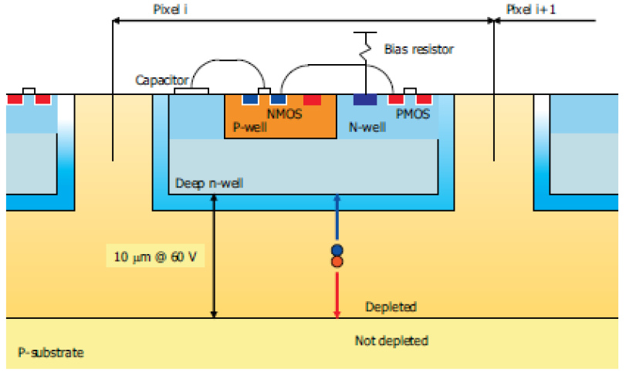
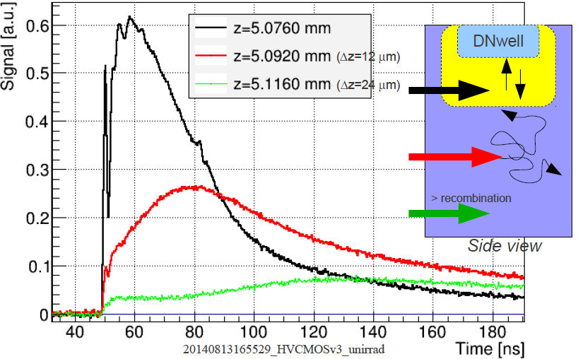
CMOS & monolithic devices
RD50 started to work on HVCMOS device characterization in 2014
close collaboration with ATLAS HVCMOS group and strip CMOS group
RD50 focus on characterizing radiation damage.
Typical (HV-)CMOS device
Depleted active pixel detectors implemented in CMOS process
Sensor element is deep n-well in (usually) low resistivity (~10 Ωcm) p-type substrate
Depletion with 60 V ~ 10 μm → charge collection via drift of ~1000 electrons
Pixel and strip detectors possible
Charcterize e.g. edge-TCT measurements
Drift and Diffusion component visible
Diffusion part will quickly disappear with irradiation
M. Fernandez, 25th RD50 Workshop, Nov. 2014

Slide 21
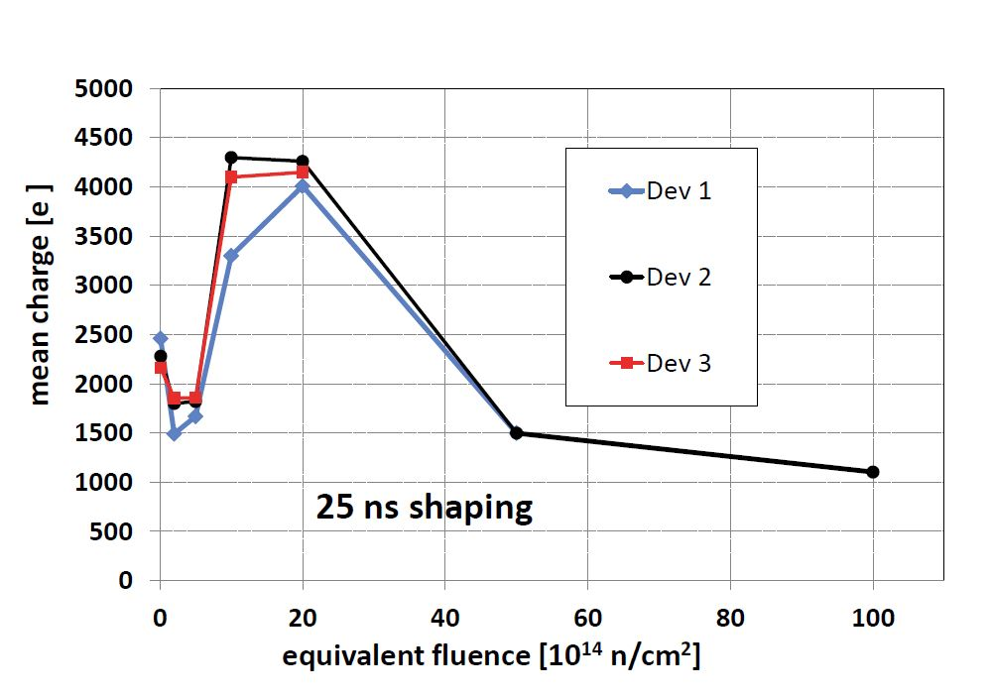
HVCMOS – CCE as function of fluence
350nm – neutron irradiation
AMS, 350nm, CHESS-1, 20 Ωcm (7.10¹⁴cm⁻³)
2mm x 2mm passive sensor (400 pixel)
Sr⁹⁰, 25 ns shaping, 120 V
180nm – neutron irradiation
AMS, 180nm, HV2FEI4, 10 Ωcm (1.4.10¹⁵cm⁻³)
100μm x 100 μm passive pixel
IR-laser, 5 ns integration
[M.Fernandez-Garcia et al, 2016 JINST 11 P02016]
[A.Affolder et al., 2016 JINST 11 P04007, Strip CMOS collaboration]
CCE rising above initial value for fluences in order of some 10¹⁵ n_{eq}/cm²
Up to about 10¹⁵ n_{eq}/cm² CCE decreases [diffusing charge gets trapped]
Above about 10¹⁵ n_{eq}/cm² CCE rises above initial value [reduction of N_{eff} , “acceptor removal”]
Above some 10¹⁵ n_{eq}/cm² CCE finally degrading [trapping, increase of space charge N_{eff}]

Slide 22
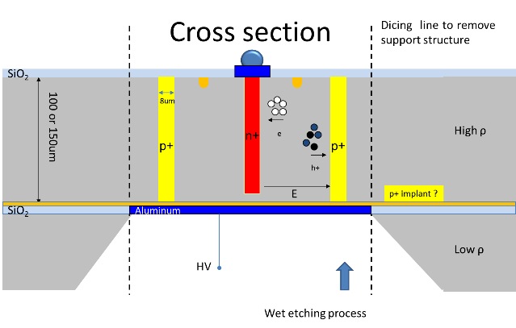
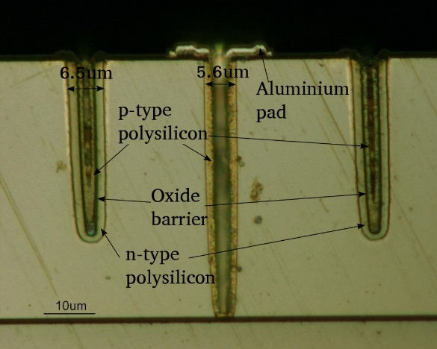
3D detectors
Development of 3D silicon sensors for innermost pixel layers at HL-LHC
Low depletion voltage (low power dissipation)
Low drift length (reduced trapping)
Testbeam data
Testbeam [ATLAS-ITK; FE-I4 3D modules]
97.5% hit efficiency at 9x10¹⁵n_{eq}/cm²
Several recent production runs [RD50 projects]
joint 3D MPW pixel run with ATLAS, CMS, LHCb
Various layouts, small pitch [μm²] 50x50, 25x100, 50,125,..
technology studies on SOI wafers
small holes: down to 8um diameter at 230um depth or 5 um in single side 3D on SOI (50, 100 or 150 um layer)
temporary metal layers for pixel testing before UBM implemented
3D sensor concept
Implementation as double and single sided (see below) process
[I.Lopez et al., IFAE,UAB, RD50 Workshop, 12/2015]
[G.Pellegrini, RD50 Workshop, 12/2015]

Slide 23
Workplan for 2016/2017 (1/2)
Defect and Material Characterization (Convener (new) : Ioana Pintilie)
Consolidate list of defects and their impact on sensor properties (Input to simulation group) including introduction rates & annealing for different type of irradiations and materials
Extend work on p-type silicon including low resistivity material
Understand boron removal in lower resistivity p-type silicon: Performance of MAPS, CMOS sensors, LGAD … adding new macroscopic measurements
Working group on acceptor removal formed!
Characterization of Nitrogen enriched silicon (starting p)
Detector Characterization (Convener: E.Fretwurst, University of Hamburg, Germany)
TCAD sensor simulations
Cross-calibration of different simulation tools (ongoing) and comparison of “TCAD models”
Refine defect parameters used for modeling (from effective to measured defects)
Extend modeling on charge multiplication processes
Surface damage working group (….)
CCE and IV versus temperature
Extend experimental capacities on edge-TCT (implement set-up at more RD50 institutions)
Parameterization of electric field (fluence, annealing time, etc.)
Studies on charge multiplication processes
Understand potential of Two Photon Absorption for sensor characterization
Continue parameterization of radiation damage (performance degradation) of LHC like sensors !
Explore fluence range to10¹⁷cm⁻²and beyond (to prepare for future needs in forward physics and FCC)

Slide 24
Workplan for 2016/2017 (2/2)
New structures (Convener: Giulio Pellegrini, CNM Barcelona, Spain)
Continue work on thin and 3D sensors (especially in combination with high fluence)
Continue characterization of dedicated avalanche test structures (LGAD, DD-APD)
Understand impact of implant shape and other geometrical parameters on avalanche processes
Study of Gallium based amplification layers and impact of Carbon co-implantation
LGAD, DD-APD: intensify evaluation of timing performance and radiation degradation (Where are the limits?) Continue to evaluate the possibility for application in ATLAS HGTD, CTPPS, CMS timing layers, …
HVCMOS
Continue characterization of existing devices (close collaboration with ATLAS HVCMOS working group)
End of year: submission of first RD50 devise in an engineering run on AMS 35 process
Full detector systems (Convener: G.Kramberger, Ljubljana University, Slovenia)
Further studies of thin (low mass) segmented silicon devices
Study performance of thin and avalanche sensors in the time domain (Fast sensors!)
Long term annealing of segmented sensors (parameterize temperature scaling)
Continue study on “mixed” irradiations (segmented detectors)
Continue RD50 program on slim edges, edge passivation and active edges
Links with LHC experiments and their upgrade working groups
Continue collaboration on evaluation of radiation damage in LHC detectors
Continue common projects with LHC experiments on detector developments

Slide 25
RD50 common projects
RD50 common projects
Part of the RD50 R&D is performed within “RD50 common projects”
Projects involving several RD50 institutes, one lead institution, evaluated by RD50, co-funded from RD50 fund, well defined time-line and objectives targeting a specific R&D question
Most recent projects
2014-01 UBM for Avalanche Sensors (Giulio Pellegrini, CNM, Spain)
2014-02 Avalanche PAD sensors (Giulio Pellegrini, CNM, Spain)
2014-03 Sensors with ADVACAM (Anna Macchiolo, MPI, Munich)
2014-04 RD50 common test beam (Marco Bomben, LPHNE, Paris )
2014-05 Investigation of the properties of thin LGAD (Nicolo Cartiglia, Torino, Italy)
2015-02 3D sensors for HL-LHC (Marcos Fernandez Garcia, Santander, Spain)
2015-03 Evaluation of Two Photon Absorption - TPA (Ivan Vila, Santander, Spain)
2015-04 Doping profiling of LGAD and other devices (Hartmut Sadrozinski, SCIPP, USA)
2016-01 NitroSil project: Nitrogen doped silicon (Alexander Dierlamm, Karlsruhe, Germany)
2016-02 Gallium doping (David Flores, CNM, Barcelona)
Under discussion
Surface damage simulation (Marco Bomben, LPHNE Paris)
Carbon enrichment of silicon (Gregor Kramberger, Ljubljana)
RD50 CMOS submission (Gianluigi Casse, Liverpool, UK / Vitaliy Fadeyev, SCIPP, USA)
RD50 pion irradiation (Tilman Rohe, PSI, Switzerland)

Slide 26
RD50 main achievements & links to LHC Experiments
Some important contributions of RD50 towards the LHC upgrade detectors:
p-type silicon (brought forward by RD50 community) is the base line option for the ATLAS and CMS Strip Tracker upgrades
n- MCZ and oxygenated Silicon (introduced by RD50 community) might improve performance in mixed fields due to compensation of neutron and proton damage: MCZ is under investigation in ATLAS, CMS and LHCb
Double column 3D detectors developed within RD50 with CNM and FBK. Development was picked up by ATLAS and further developed for ATLAS IBL needs.
RD50 results on very highly irradiated planar segmented sensors have shown that these devices are a feasible option for the LHC upgrade
RD50 data are essential input parameters for planning the running scenarios for LHC experiments and their upgrades (evolution of leakage current, CCE, power consumption, noise,….) and sensor design (TCAD parameters).
Charge multiplication effect observed for heavily irradiated sensors (diodes, 3D, pixels and strips). Dedicated R&D launched in RD50 to understand underlying multiplication mechanisms, simulate them and optimize the CCE performances. Evaluating possibility to produce fast segmented sensors?
New characterization techniques for the community: Edge-TCT, Alivaba readout, TPA-TCT, … part of them now available through spin-off companies.
Close links to the LHC Experiments:
Many RD50 groups are involved in ATLAS, CMS and LHCb upgrade activities (natural close contact).
Common projects with Experiments: Irradiation campaigns, test beams, wafer procurement and common sensor projects.
Close collaboration with LHC Experiments on radiation damage issues of present detectors.

Slide 27
Device Characterization

Slide 28
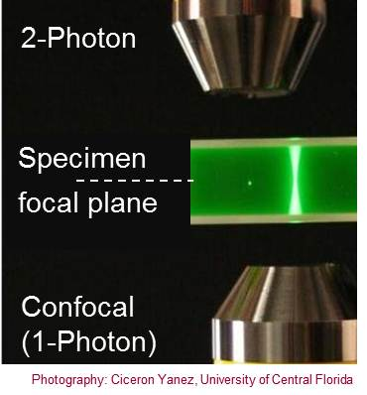
TPA – Two Photon Absorption
Two Photon absorption:

Slide 29
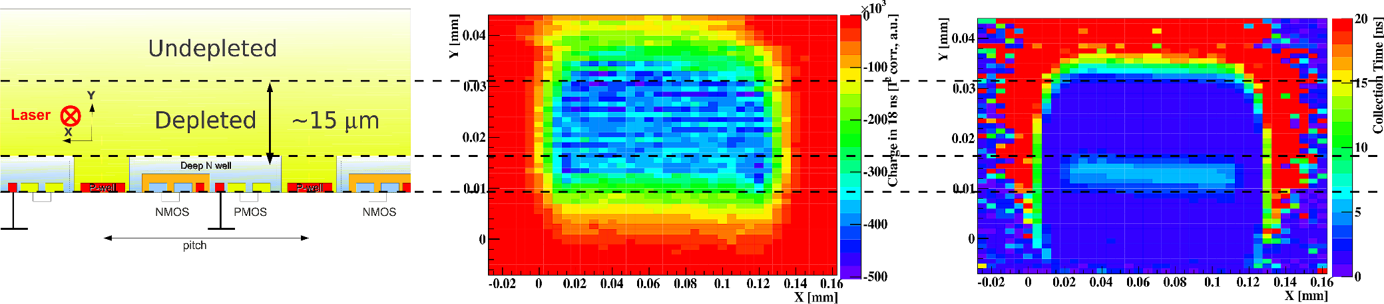
TPA – Two Photon Absorption
Two Photon absorption:
Investigation on a new technique for sensor characterization (TPA – TCT)
Deposition of charge at specific position in detector
Laser: λ ∼ 1300 nm; P ∼ 50-100 pJ; ΔT ∼ 240 fs
Proof of principle presented last LHCC
Example of application:
HVCMOS sensors (AMS 180nm), 10 ohmcm
100μm x 100 μm passive pixel, measured at 80V, 20°C
[M.Fernandez-Garcia et al, VCI 2016, Feb.2016]
Map of charge collected within 10ns
Map of collection time needed to get 98% of charge
Sketch of HVCMOS sensor

Slide 30
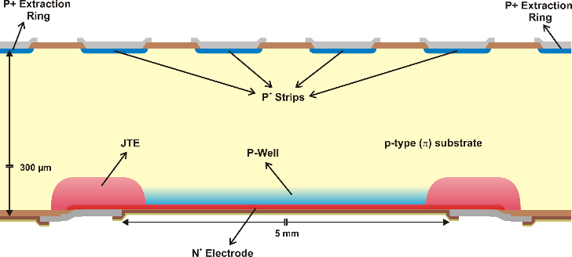
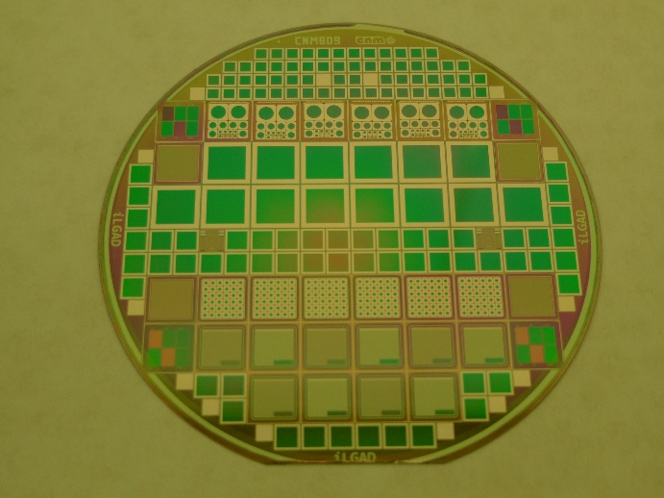
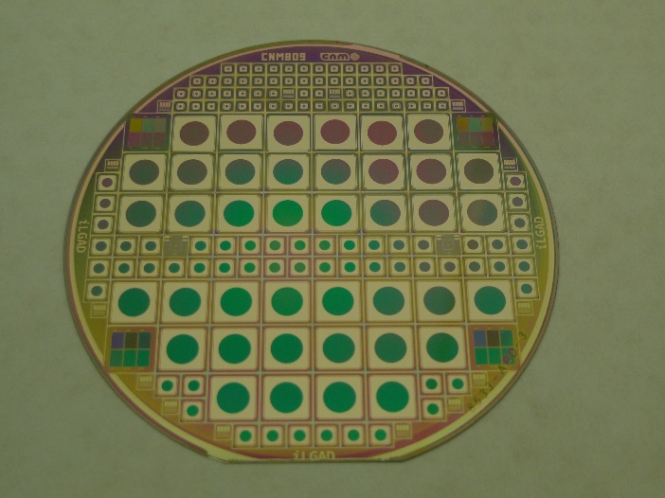
The “inverse LGAD” – iLGAD
Decouple multiplication layer from segmented electrodes
Strip, pixel and pad structures with this configuration produced in 2016
First wafers show good electrical performance (CV,IV), intensive testing ahead
Front-Side
Back-Side
[G.Pellegrini, CNM, May 2016, private communication]

Slide 31
Spare Slides
Some spare slides
More details on http://www.cern.ch/rd50/
Most results presented here have been shown on the last RD50 Workshop

Slide 32
Recent key results
Progress in understanding microscopic defects
Defects responsible for positive space charge in DOFZ, MCZ and EPI and defects provoking reverse annealing are characterized!
Consistent list of defects produced covering electron, gamma, neutron and proton/pion damage
TCAD simulations : Good progress on simulations [Note: RD50 profiting from strong CMS simulation group]
Commercial TCAD packages well understood and proved to be well adopted to our needs (defect description)
Simulations can reproduce pulse shapes, depletion voltage, charge collection and leakage current. Getting predictive capabilities!
Systematic analysis of the Charge multiplication mechanism and exploitation as timing detector
Noise issue particularly important for exploitation of this feature in Experiments
New dedicated sensors produced to test avalanche effects, working after irradiation up to some 10¹⁴, good timing performance
Consolidation of data obtained on p-type and thin segmented sensors
Further results on radiation tolerance and further results on long term annealing
Thin sensors seem to extend fluence reach of silicon detectors; Optimization: Optimum thickness depends on many parameters !
Slim and active edges
Further progresses towards reduction of insensitive area (edges) of detectors
New structures based on mixed technologies
Exploitation of DRIE etching: 3D-trench electrode, semi-3D sensors; planar strip with trenched electrodes, active edge planar pixel; Use of deep implantation for controlling avalanches.
Use of tools developed in framework of RD50: ALIBAVA & Edge-TCT & Beam telescope
Edge-TCT and TCT systems are now produced centrally and can be procured by interested groups
Use of the ALIBAVA readout system in many RD50 institutions

Slide 33
Summary on defects with strong impact on device performance after irradiation
Most important defects [for details and references see JAP 117, 164503, 2015]

Slide 34
Summary of LGAD Activities at IMB-CNM Clean Room
No. Run | Tipo | # Wafers | PiN Waf | Mask Set | P-Well | Drive-in | Implant Mask | Year
5176 | 1st APD | 8 | - | CNM 458 | 3 Doses | Long | Photoresist | 2010
5646 | 2nd APD | 9 | 2 | CNM 458 | 6 Doses | Short | Photoresist | 2010
5730 | 3^{rh} APD | 4 | 2 | CNM 458 | 2 Doses | Short | Oxide | 2011
5870/5883 | 4th APD | 4 | - | CNM 458 | 2 Doses | Short | Oxide | 2011
5944/5982 | 5th APD | 5 | 1 | CNM 458 | 3 Doses | Short | Oxide | 2011
6474 | 1st LGAD | 11 | 1 | CNM 652 | 8 Doses | Short | Oxide | 2012
6884/6951 | 2nd LGAD | 13 | 1 | CNM 652 | 3 Doses | Short | Oxide | 2013
6984/7062 | 3th LGAD | 7 | 1 | CNM 652 | 3 Doses | Short | Oxide | 2013
7509 | 4^{rh} LGAD | 7 | 1 | CNM 761 | 3 Doses | Short | Oxide | 2014
7735 | 1st Gallium | 3 | - | CNM 761 | 3 Doses | Short | Oxide | 2014
7782/8642 | 1st 200 µm | 10 | - | CNM 761 | 5 Doses | Short | Oxide | 2014

Slide 35
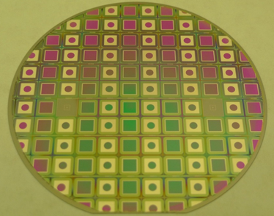
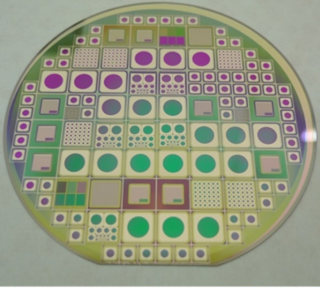
Summary of LGAD Activities at IMB-CNM Clean Room
No. Run | Tipo | # Wafers | PiN Waf | Mask Set | P-Well | Drive-in | Implant Mask | Year
7859 | 5th LGAD | 6 | - | CNM 761 | 3 Doses | Short | Oxide | 2015
8373 | 1st SOI 6” | 4 | 2 | CNM 784 | 1 Dose | Short | Oxide | 2015
8533 | 1st iLGAD | 6+3 | - | CNM 809 | 2 Doses | Short | Oxide | 2015
8622 | 6th LGAD | 6+3 | - | CNM 761 | 2 Doses | Short | Oxide | 2016
9088 | 1st SOI 50 µm | 14 | 1 | CNM 827 | 3 Doses | Short | Oxide | 2016
9089 | Ga diodes | 15 | 15 | CNM 809 | - | Short/Long | Oxide | 2016
9254 | 2nd Epi 50 & 75um | 5 | - | CNM 827 | 1 Dose | Short | Oxide | 2016
Good
Under electrical testing
In fabrication
Calibration run
R&D mainly financed by Spanish research project and partially by CERN RD50 collaboration

Slide 36
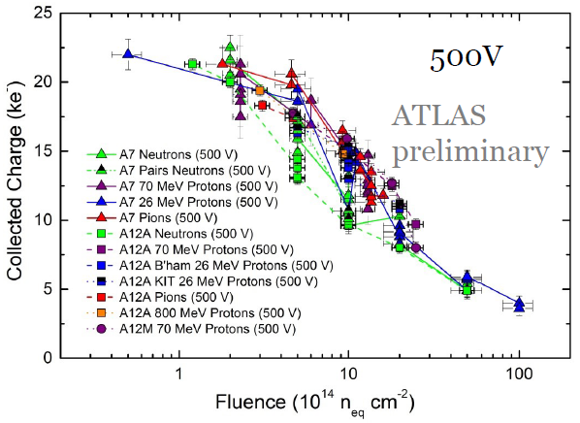
Reminder: Segmented sensors: n⁺ vs. p⁺ readout
p-type strip sensors with n⁺ readout (brought forward by RD50)
are now the sensor choice for ATLAS and CMS Tracker upgrades
n⁺-electrode readout (“natural in p-type silicon”):
favorable combination of weighting and electric field in heavily irradiated detector
electron collection, multiplication at segmented electrode
Situation after high level of irradiation:
S. Wonsak, 25th RD50 Workshop Nov. 2014
p⁺ readout
n⁺ readout
[G. Kramberger, Vertex 2012]
p⁺
readout
n⁺
p⁺
n⁺
readout
holes
electrons

Slide 37
TCAD - Simulations
Device simulation of irradiated sensors
Using: Custom made simulation software and Silvaco & Synopsis TCAD tools
RD50 simulation working group
Good progress in reproducing experimental results on leakage current, space charge, E-Field, trapping …..
However, …. still some work on going to “inter-calibrate” the tools
Enormous parameter space ranging from semiconductor physics parameters and models over device parameters towards defect parameters ➔ Tools ready but need for proper input parameters!
Working with “effective levels” for simulation of irradiated devices
Most often 2, 3 or 4 “effective levels” used to simulate detector behavior
Introduction rates and cross sections of defects tuned to match experimental data
Measured defects TCAD input

